Slide 1
Unit 2

Slide 2
Aliasing and Anti Aliasing

Slide 3
Antialiasing is a technique used in computer graphics to remove the aliasing effect.
The aliasing effect is the appearance of jagged edges or “jaggies” in a rasterized image (an image rendered using pixels).
The problem of jagged edges technically occurs due to distortion of the image when scan conversion is done with sampling at a low frequency, which is also known as Undersampling.
Aliasing occurs when real-world objects which comprise of smooth, continuous curves are rasterized using pixels.

Slide 4
Cause of anti-aliasing is Undersampling.
Undersampling results in loss of information of the picture.
Undersampling occurs when sampling is done at a frequency lower than required sampling frequency.
To avoid this loss, we need to have our sampling frequency at least twice that of highest frequency occurring in the object.

Slide 5
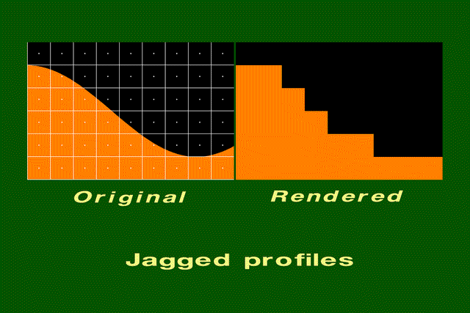
Effects caused by aliasing.
Jagged profiles.
The picture on the left shows the sampling grid superimposed on the original scene. The picture on the right is the rendered image. A jagged profile is quite evident in the rendered image.

Slide 6
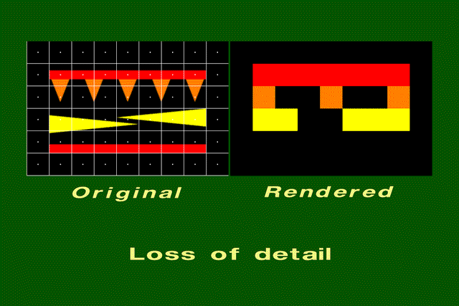
Improperly rendered detail
The original scene on the left shows a group of small polygons. In the rendered scene, one of the two red rectangles disappears entirely, and the other doubles in width. Two of the orange triangles disappear. Although the two yellow triangles are identical in size, one is larger than the other in the rendered image.

Slide 7
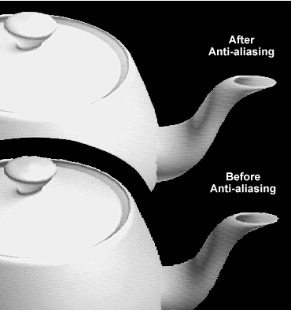

Slide 8
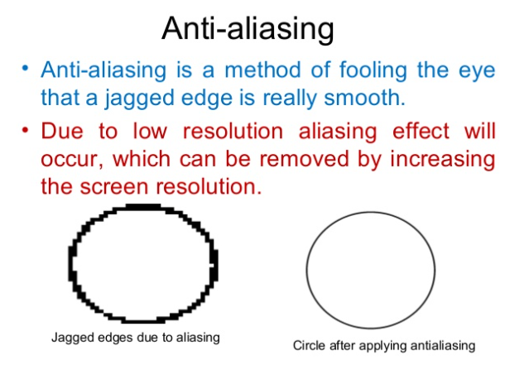

Slide 9
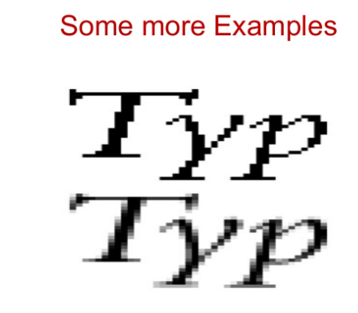

Slide 10
